Slide 1
The Boring Club Week 3

Slide 2
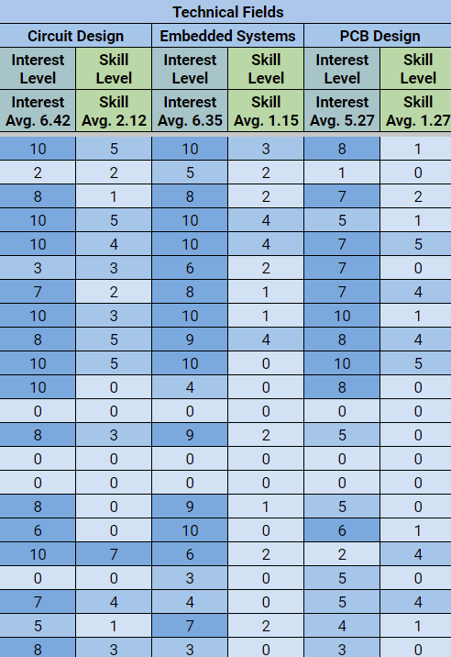
Spreadsheet
Do your check-in right now
Old rows will be deleted after today!!
This is how I will give Google Drive access to members

Slide 3
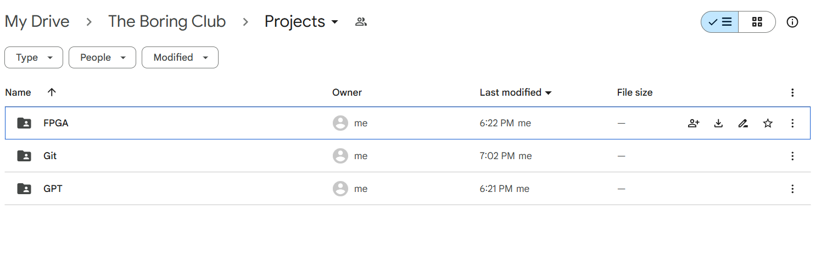
Google Drive
We keep project materials in the Projects folder
You can also find code, schematics, old meeting slides, etc.

Slide 4
Project Status Reports

Slide 5
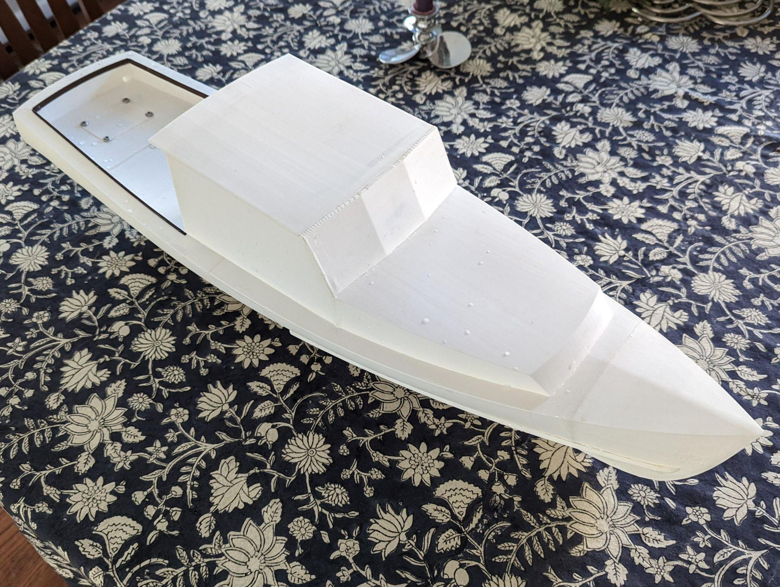
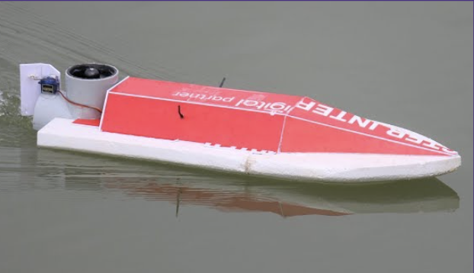
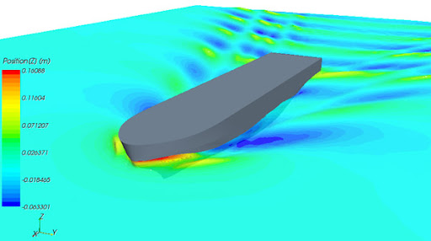
Mini Motorboat (Arjun and Zi)
Last week: Materials, vague project ideas
Project overview
Subteams
Start on Arduino

Slide 6
UW GPT (Arshan)
Getting started

Slide 7

Github/Git (Sean)
Worked on setting up Git and Github with here last week
Learned basic git cmds, config, commit, add, etc.
Learned about different file statuses
Will continue set up today as well as starting profiles for individual accounts

Slide 8
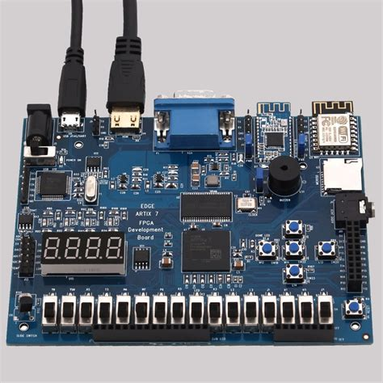
FPGA Digital System Sim (Sam)
Last week completed Boolean algebra, DeMorgan’s Law, and Truth Tables
This week looking at Karnaugh maps and beginning system design

Slide 9
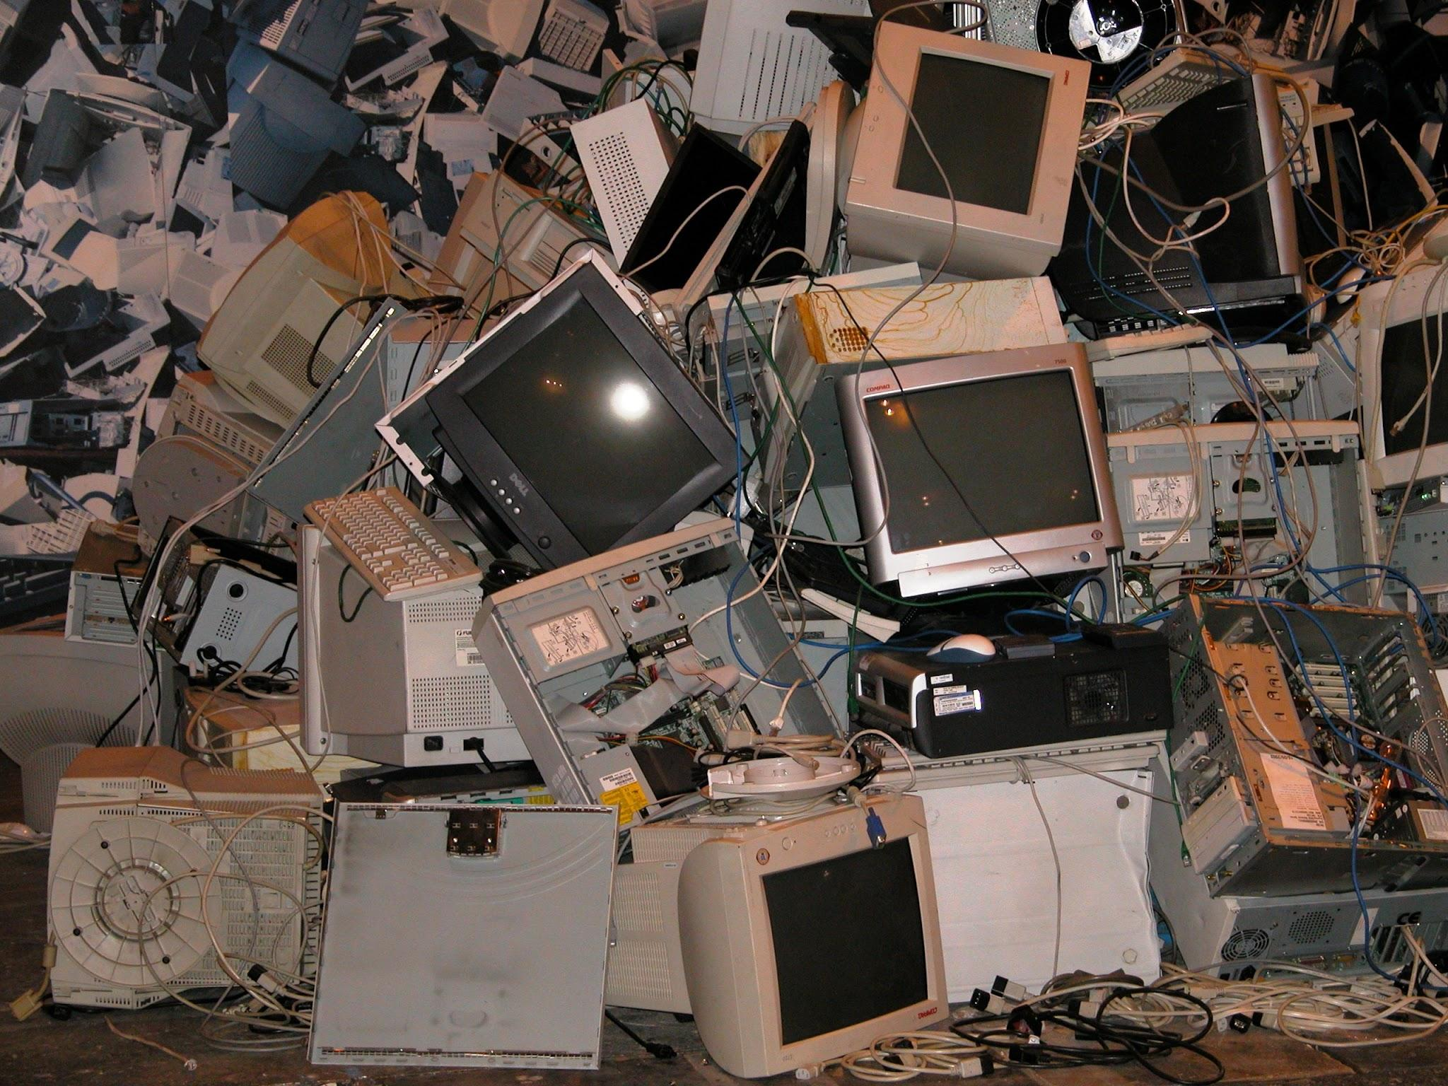

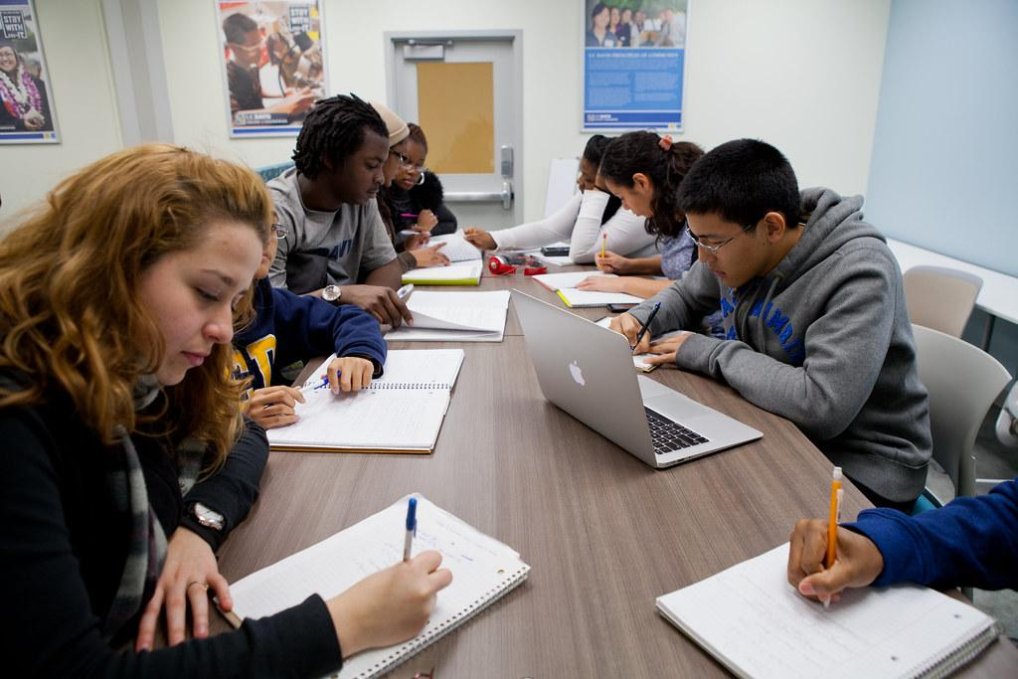
Projects
Let’s get to work!
Notes:
Josh talk about Bot if finished?

